Slide 1
Analytical Methods for Business
Dr. Ronald K. Satterfield
Muma College of Business
University of South Florida

Slide 2
Module 3 Sample v. Population Means
Dr. Ronald K. Satterfield
Muma College of Business
University of South Florida
Leveraging Samples to Understand Populations

Slide 3

Plan for This Presentation
Confidence Intervals
Hypothesis Tests
Introduction | Confidence Intervals | Hypothesis Testing | Special Cases | Conclusions

Slide 4
Confidence Intervals The Fishing Net of Statistics
Dr. Ronald K. Satterfield
Muma College of Business
University of South Florida

Slide 5
Why Confidence Intervals?
Range of Uncertainty
Probability of Uncertainty
Introduction | Confidence Intervals | Hypothesis Testing | Special Cases | Conclusions

Slide 6

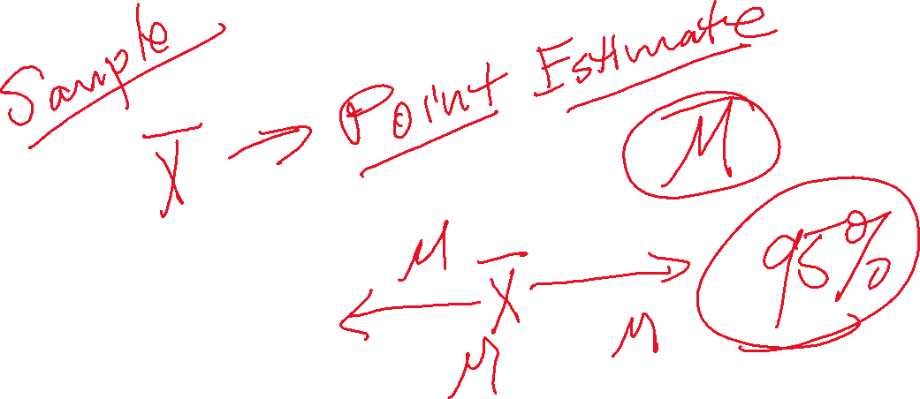
The Point Estimate
Introduction | Confidence Intervals | Hypothesis Testing | Special Cases | Conclusions

Slide 7

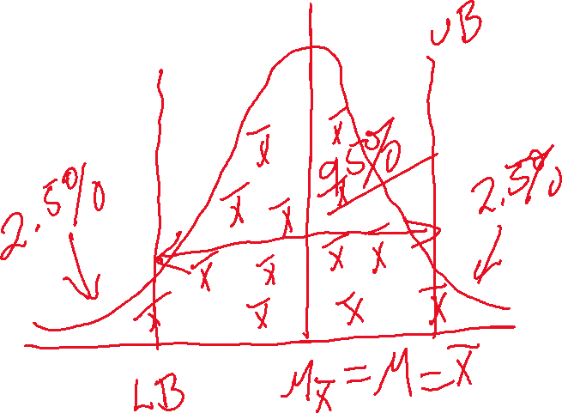

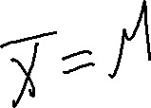


Relationship to the Sampling Distribution
Standard Deviation of the Sampling Distribution
“Middle 95%” of the Sampling Distribution
Introduction | Confidence Intervals | Hypothesis Testing | Special Cases | Conclusions

Slide 8
An Example: 50 GPAs
Introduction | Confidence Intervals | Hypothesis Testing | Special Cases | Conclusions

Slide 9

Width of the Confidence Interval
Impact of Variation in the Sample
Impact of Sample Size
Introduction | Confidence Intervals | Hypothesis Testing | Special Cases | Conclusions

Slide 10
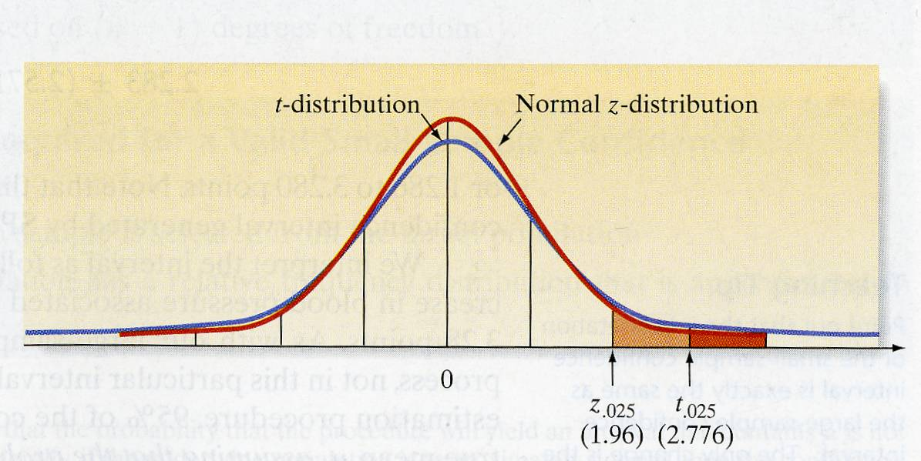




A New Statistical Distribution The t Distribution
Introduction | Confidence Intervals | Hypothesis Testing | Special Cases | Conclusions

Slide 11
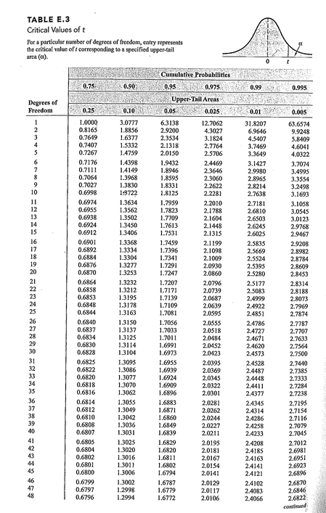
A New Statistical Distribution The t Distribution
Introduction | Confidence Intervals | Hypothesis Testing | Special Cases | Conclusions

Slide 12
Why the t Distribution?
When the population standard deviation is unknown
When the sample size is too small for the CLT
Introduction | Confidence Intervals | Hypothesis Testing | Special Cases | Conclusions

Slide 13
An Example: 15 GPAs
Introduction | Confidence Intervals | Hypothesis Testing | Special Cases | Conclusions

Slide 14
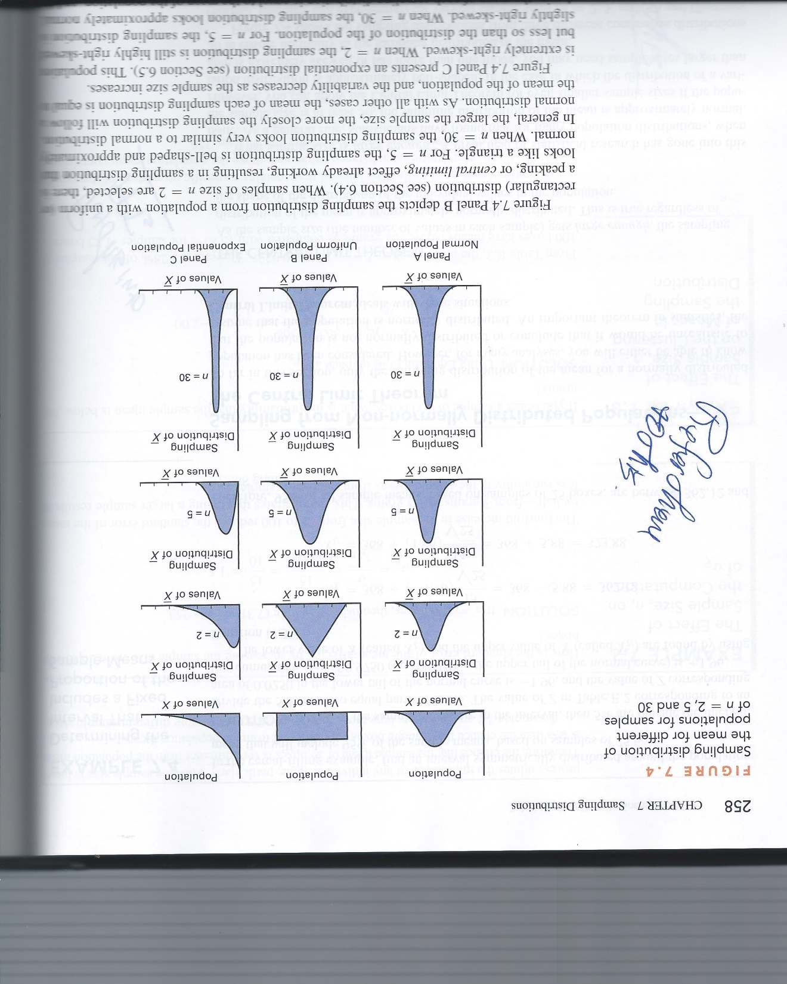
The Problems With Small Sample Sizes
Loss of Statistical Precision
Introduction | Confidence Intervals | Hypothesis Testing | Special Cases | Conclusions

Slide 15




What Have We Covered in this Section?
Basic Idea of Confidence Intervals
Reasons for Confidence Intervals
Calculation & Interpretation
The t Distribution
Impacts of Sample Variation
Impacts of Small Sample Size
Introduction | Confidence Intervals | Hypothesis Testing | Special Cases | Conclusions

Slide 16
Hypothesis Testing Guilty or Not Guilty
Dr. Ronald K. Satterfield
Muma College of Business
University of South Florida

Slide 17
Why Hypothesis Testing?
Done to show clear statistical evidence
of something happening or not happening.
Introduction | Confidence Intervals | Hypothesis Testing | Special Cases | Conclusions

Slide 18


Important Terminology
Null Hypothesis
Alternate Hypothesis
Type I Error
Type II Error
Test Statistic
Critical Value
Introduction | Confidence Intervals | Hypothesis Testing | Special Cases | Conclusions

Slide 19










Steps in Hypothesis Testing
Step 1: You have an idea.
Step 2: Formulate Null and Alternate Hypotheses. (H₀ and H₁)
Step 3: Analyze data to determine a sample mean, sample size, and sample standard deviation.
Step 4: Calculate the test statistic to test the Null.
Step 5: Determine a critical value.
Step 6: Reject the Null and Accept the Alternate OR Fail to Reject the Null.
Introduction | Confidence Intervals | Hypothesis Testing | Special Cases | Conclusions

Slide 20


An Example
Suppose building specifications in a certain city require that the average breaking strength of residential sewer pipe be more than 2,400 pounds per foot length. Each manufacturer who wants to sell pipe in this city must demonstrate that its product meets the specification. For one manufacturer we take a sample of 50 sections of sewer pipe and apply pressure to each section until it breaks. The mean breaking point for the 50 sections is 2,460 pounds and the sample standard deviation is 200 pounds.
Introduction | Confidence Intervals | Hypothesis Testing | Special Cases | Conclusions

Slide 21


Introduction | Confidence Intervals | Hypothesis Testing | Special Cases | Conclusions

Slide 22




Steps in Hypothesis Testing
Step 1: You have an idea.
Step 2: Formulate Null and Alternate Hypotheses. (H₀ and H₁)
Step 3: Analyze data to determine a sample mean, sample size, and sample standard deviation.
Step 4: Calculate the test statistic to test the Null.
Step 5: Determine a critical value.
Step 6: Reject the Null and Accept the Alternate OR Fail to Reject the Null.
Introduction | Confidence Intervals | Hypothesis Testing | Special Cases | Conclusions

Slide 23










Steps in Hypothesis Testing
Step 1: You have an idea.
Step 2: Formulate Null and Alternate Hypotheses. (H₀ and H₁)
Step 3: Analyze data to determine a sample mean, sample size, and sample standard deviation.
Step 4: Calculate the test statistic to test the Null.
Step 5: Determine a critical value.
Step 6: Reject the Null and Accept the Alternate OR Fail to Reject the Null.
Introduction | Confidence Intervals | Hypothesis Testing | Special Cases | Conclusions

Slide 24



Sewer Pipe Hypotheses
Null Hypothesis
Alternate Hypothesis
Introduction | Confidence Intervals | Hypothesis Testing | Special Cases | Conclusions

Slide 25




Steps in Hypothesis Testing
Step 1: You have an idea.
Step 2: Formulate Null and Alternate Hypotheses. (H₀ and H₁)
Step 3: Analyze data to determine a sample mean, sample size, and sample standard deviation.
Step 4: Calculate the test statistic to test the Null.
Step 5: Determine a critical value.
Step 6: Reject the Null and Accept the Alternate OR Fail to Reject the Null.
Introduction | Confidence Intervals | Hypothesis Testing | Special Cases | Conclusions

Slide 26



Steps in Hypothesis Testing
Step 1: You have an idea.
Step 2: Formulate Null and Alternate Hypotheses. (H₀ and H₁)
Step 3: Analyze data to determine a sample mean, sample size, and sample standard deviation.
Step 4: Calculate the test statistic to test the Null.
Step 5: Determine a critical value.
Step 6: Reject the Null and Accept the Alternate OR Fail to Reject the Null.
Introduction | Confidence Intervals | Hypothesis Testing | Special Cases | Conclusions

Slide 27


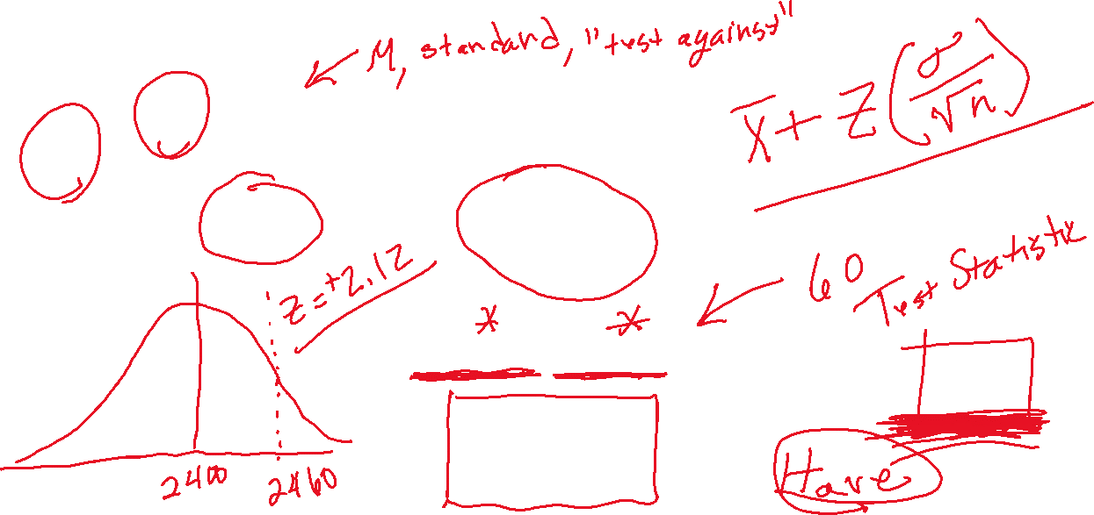
The Test Statistic
Introduction | Confidence Intervals | Hypothesis Testing | Special Cases | Conclusions

Slide 28




Steps in Hypothesis Testing
Step 1: You have an idea.
Step 2: Formulate Null and Alternate Hypotheses. (H₀ and H₁)
Step 3: Analyze data to determine a sample mean, sample size, and sample standard deviation.
Step 4: Calculate the test statistic to test the Null.
Step 5: Determine a critical value.
Step 6: Reject the Null and Accept the Alternate OR Fail to Reject the Null.
Introduction | Confidence Intervals | Hypothesis Testing | Special Cases | Conclusions

Slide 29







Type I Error
Rejecting the Null Hypothesis when it really is true.
Introduction | Confidence Intervals | Hypothesis Testing | Special Cases | Conclusions

Slide 30
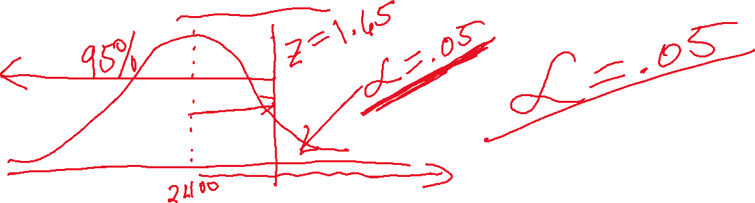



Probability of Committing a Type I Error
: The Probability of rejecting the Null Hypothesis when it really is true.
Introduction | Confidence Intervals | Hypothesis Testing | Special Cases | Conclusions

Slide 31
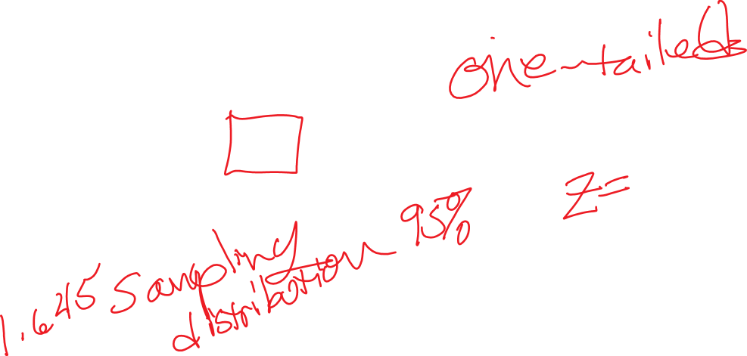
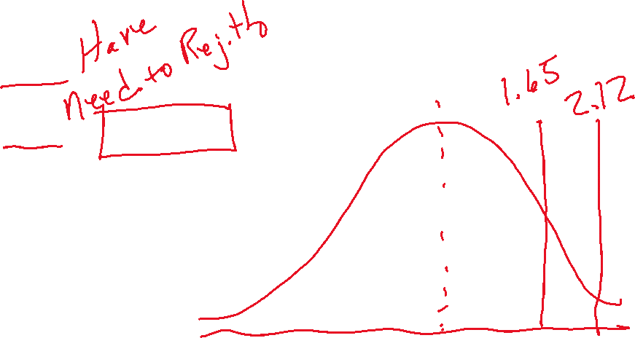

Test Statistic v. Critical Value
Test Statistic: 2.12
Critical Value: 1.65 at = .05
Introduction | Confidence Intervals | Hypothesis Testing | Special Cases | Conclusions

Slide 32


Steps in Hypothesis Testing
Step 1: You have an idea.
Step 2: Formulate Null and Alternate Hypotheses. (H₀ and H₁)
Step 3: Analyze data to determine a sample mean, sample size, and sample standard deviation.
Step 4: Calculate the test statistic to test the Null.
Step 5: Determine a critical value.
Step 6: Reject the Null and Accept the Alternate OR Fail to Reject the Null.
Introduction | Confidence Intervals | Hypothesis Testing | Special Cases | Conclusions

Slide 33



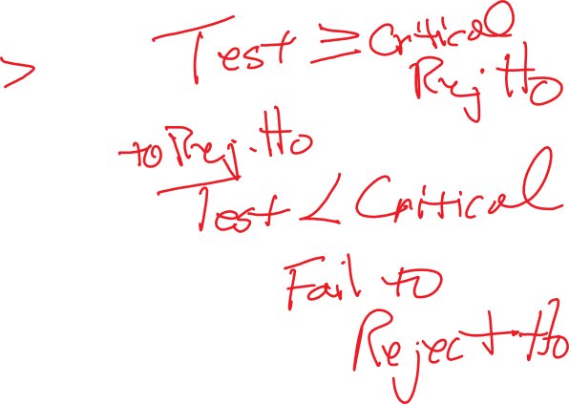
Test Statistic v. Critical Value
Test Statistic: 2.12
Have
Critical Value: 1.65 at = .05
Need
Reject H_{o} when Test > Critical
“Exceeding the Standard”
Have more than we Need
Introduction | Confidence Intervals | Hypothesis Testing | Special Cases | Conclusions

Slide 34
Sewer Pipe Hypotheses
Null Hypothesis
Alternate Hypothesis
Introduction | Confidence Intervals | Hypothesis Testing | Special Cases | Conclusions

Slide 35

Conclusion of Test
Reject the Null Hypothesis at = .05 and conclude the manufacturer’s pipe exceeds the 2400 pound standard.
Introduction | Confidence Intervals | Hypothesis Testing | Special Cases | Conclusions

Slide 36
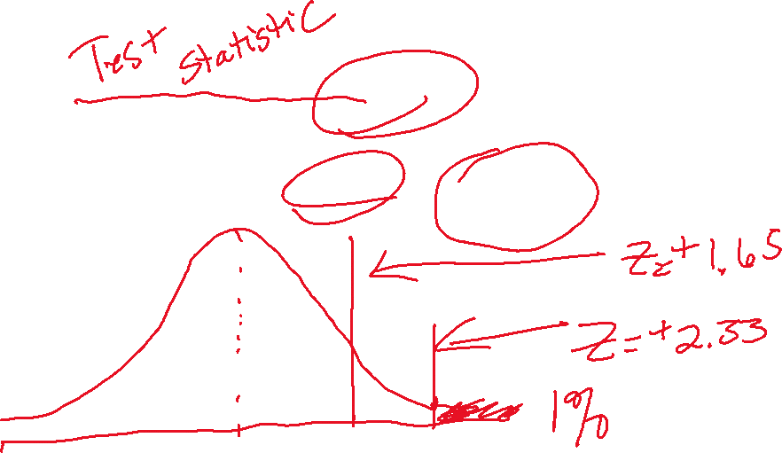
A Higher Standard
Calculated Value: 2.12
Have
Critical Value: 2.33 at = .01
Need
Introduction | Confidence Intervals | Hypothesis Testing | Special Cases | Conclusions

Slide 37

Conclusion
Fail to reject the Null Hypothesis
at = .01. Not enough evidence to conclude the manufacturer’s pipe exceeds the specified standard.
Introduction | Confidence Intervals | Hypothesis Testing | Special Cases | Conclusions

Slide 38




Type I Error
Rejecting the Null Hypothesis when it really is true.
Introduction | Confidence Intervals | Hypothesis Testing | Special Cases | Conclusions

Slide 39
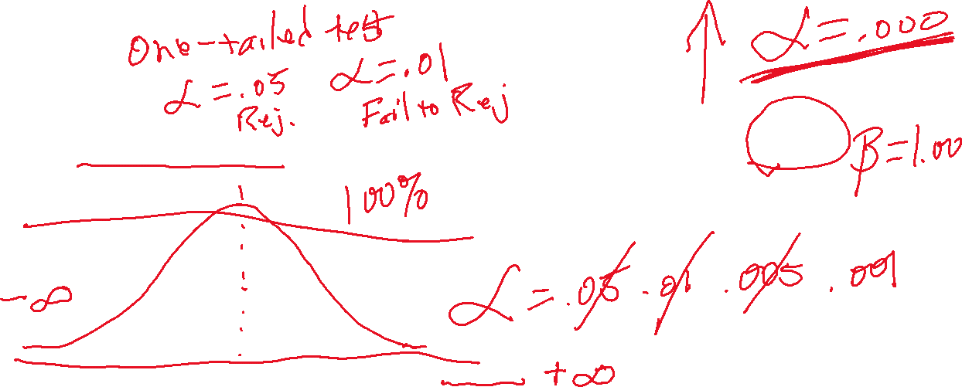
Type II Error
Failing to reject the Null Hypothesis when it really is false.
Introduction | Confidence Intervals | Hypothesis Testing | Special Cases | Conclusions

Slide 40


Probability of Committing a Type I Error
: The Probability of rejecting the Null Hypothesis when it really is true.
Introduction | Confidence Intervals | Hypothesis Testing | Special Cases | Conclusions

Slide 41



Probability of Committing a Type II Error
: The Probability of failing to reject the Null Hypothesis when it really is false.
More difficult to determine Type II Error. Most people focus on Type I because they can control (even specify) that. Need to make certain courageous assumptions to estimate the risk of Type II error.
Introduction | Confidence Intervals | Hypothesis Testing | Special Cases | Conclusions

Slide 42


What If the Pipe Question Changed?
Suppose building specifications in a certain city require that the average breaking strength of residential sewer pipe be 2,400 pounds per foot length. Each manufacturer who wants to sell pipe in this city must demonstrate that its product meets the specification. For one manufacturer we take a sample of 50 sections of sewer pipe and apply pressure to each section until it breaks. The mean breaking point for the 50 sections is 2,460 pounds and the sample standard deviation is 200 pounds.
Introduction | Confidence Intervals | Hypothesis Testing | Special Cases | Conclusions

Slide 43
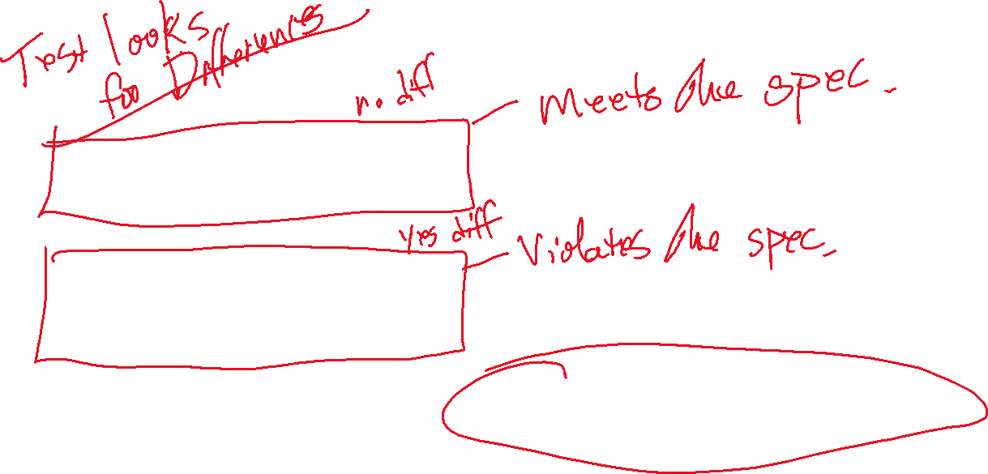
New Alternate Hypothesis
Null Hypothesis
Alternate Hypothesis
This is a Two-Tailed Test
Introduction | Confidence Intervals | Hypothesis Testing | Special Cases | Conclusions

Slide 44
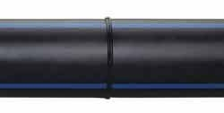
Introduction | Confidence Intervals | Hypothesis Testing | Special Cases | Conclusions

Slide 45
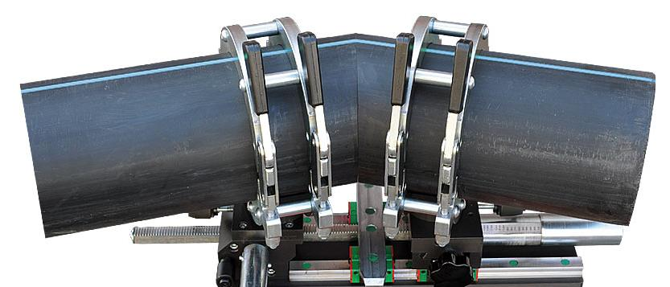
Introduction | Confidence Intervals | Hypothesis Testing | Special Cases | Conclusions

Slide 46
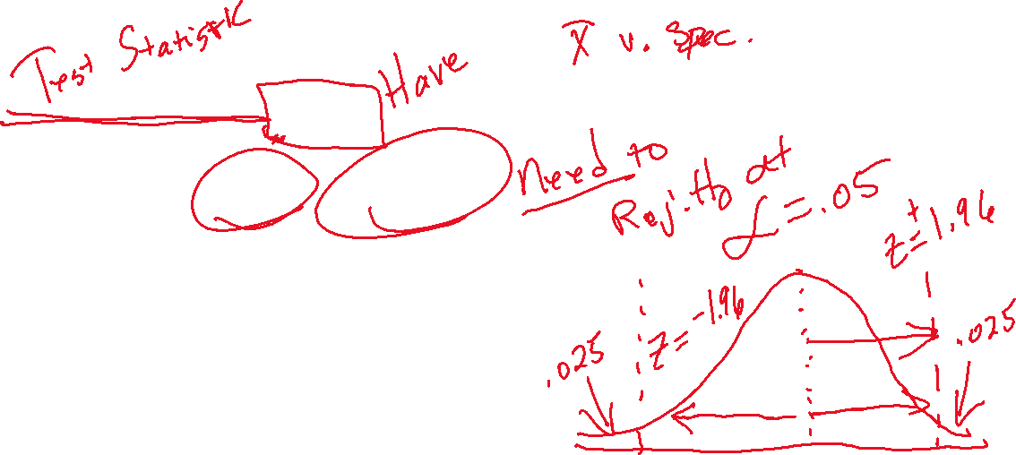
Test Statistic v. Critical Value
Calculated Value: 2.12
Critical Value: 1.96 at = .05
Reject H_{o} when Test > Critical
Introduction | Confidence Intervals | Hypothesis Testing | Special Cases | Conclusions

Slide 47
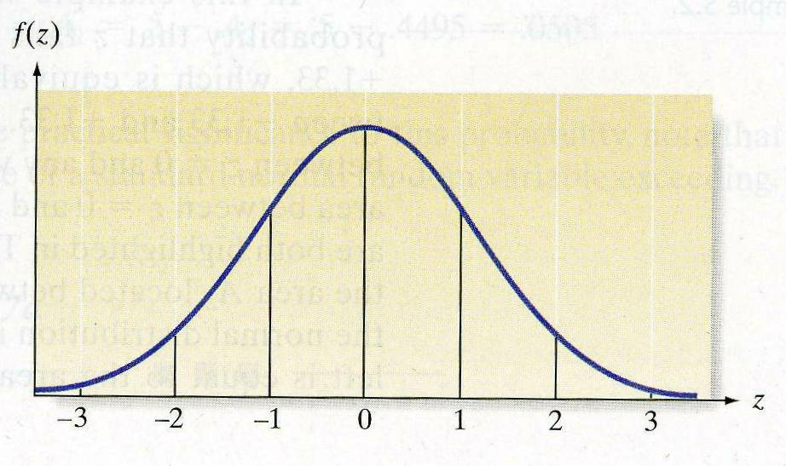
1-Tailed v. 2-Tailed
Introduction | Confidence Intervals | Hypothesis Testing | Special Cases | Conclusions

Slide 48

Conclusion of Test
Reject the Null Hypothesis at = .05 and conclude the manufacturer’s pipe is different from the 2400 pound standard.
Introduction | Confidence Intervals | Hypothesis Testing | Special Cases | Conclusions

Slide 49


Small Sample Sizes
Suppose building specifications in a certain city require that the average breaking strength of residential sewer pipe be more than 2,400 pounds per foot length. Each manufacturer who wants to sell pipe in this city must demonstrate that its product meets the specification. For one manufacturer we take a sample of 18 sections of sewer pipe and apply pressure to each section until it breaks. The mean breaking point for the 18 sections is 2,460 pounds and the sample standard deviation is 200 pounds.
Introduction | Confidence Intervals | Hypothesis Testing | Special Cases | Conclusions

Slide 50
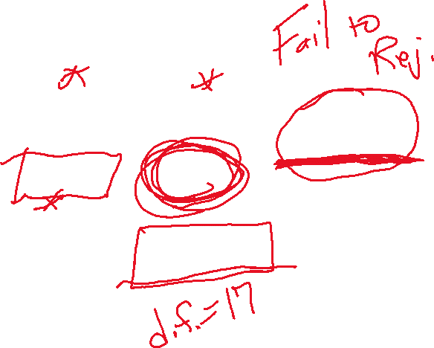


Test Statistic v. Critical t Values
Have
Critical t = 1.740
Need
Introduction | Confidence Intervals | Hypothesis Testing | Special Cases | Conclusions

Slide 51
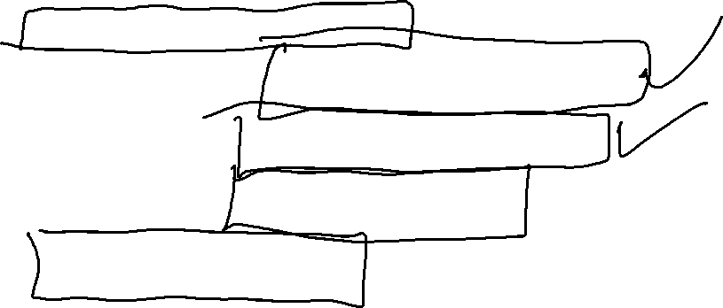
What Have We Covered in this Module?
Based in Sampling Distributions
Confidence Intervals (Large and Small Sample Sizes)
Hypothesis Tests (Large and Small Sample Sizes)
Hypothesis Tests (One- and Two-Tailed)
Type I and Type II Error
Introduction | Confidence Intervals | Hypothesis Testing | Special Cases | Conclusions

Slide 52


A Word about α and β
Typically More Attention to α
You Set α
β Is a Function of the data, sample size, and other factors
The Two are Semi-Independent
If You Decrease α, β Automatically Increases
β is Important for Power Calculations
Introduction | Confidence Intervals | Hypothesis Testing | Special Cases | Conclusions

